Slide 1

Psychological Measurement Week 6
Dr Oliver Clark

Slide 2
Learning Outcomes
Understand how Classical Test Theory relates to a Forensic Psychology assessment tool
Apply Classical Test Theory to a PCL-R Score

Slide 3

Task 1 – The Psychopath Checklist Revised
Group discussion
What is it?
How is it completed?
How is it used?
Notes:
This is to see what students already know - they may have heard of the measure in the past

Slide 4
The Psychopath Checklist Revised
Much debate about psychopathy
Psychopathy is a severe disorder of personality, incorporating key traits of pathological narcissism in addition to antisocial, histrionic, and paranoid presentations (Blackburn, 2006).

Slide 5
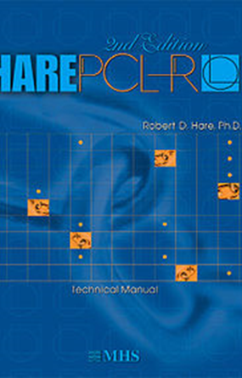
The Psychopath Checklist Revised
Semi-structured interview + file review
20 items
Overall PCL-R score
Factor and facet scores

Slide 6
2 Factor – 4 Facet Model
Psychopathy
Factor 1
Interpersonal / affective
Factor 2
Social Deviance
Facet 1
Superficial charm
Grandiose
Pathological Lying
Conning / manipulative
Facet 2
Lack of remorse
Shallow affect
Callous/Lack of empathy
Lack of responsibility
Facet 3
Need for stimulation
Parasitic lifestyle
Lack of long term goals
Impulsivity
Irresponsible
Facet 4
Poor behaviour controls
Early problems
Juvenile delinquency
Conditional release
Criminal versatility

Slide 7
The Psychopath Checklist Revised – Classical Test Theory Assumptions
A person has a ‘True’ Psychopathy Score – this would be the mean over continual assessments
For any measured PCL-R score, there will be some measurement error included
So an observed PCL-R score will be:
True score + Error
We can estimate the error with the Standard Error of Measurement
Notes:
Can anyone think of exa

Slide 8
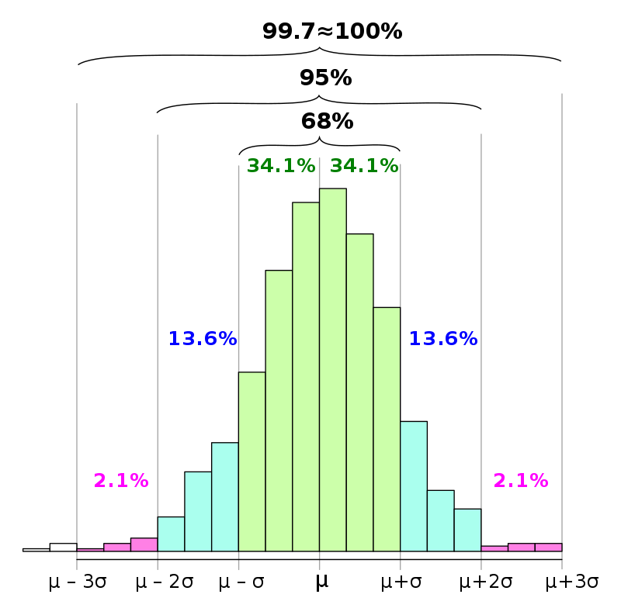
Standard Error of Measurement
Gives us a the ‘likely’ variation in an individual’s score, if they were to be tested repeatedly
We would be ’fairly confident’ that scores would fall between ±1 standard error of measurement

Slide 9
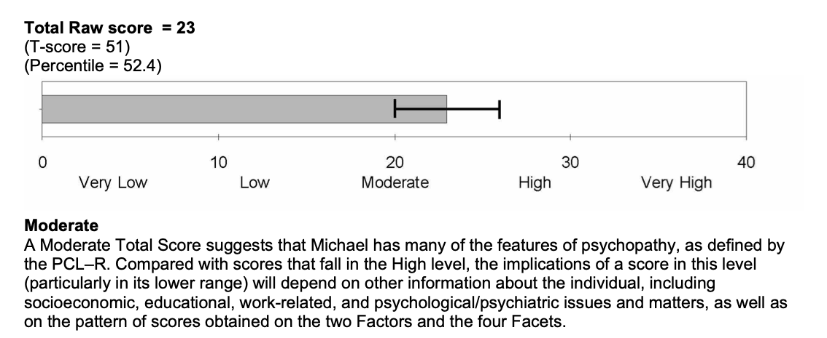
The Psychopath Checklist Revised
Notes:
This is reflected in PCL-R reports – the black I bar is the measurement error around the estimate.

Slide 10
The Psychopath Checklist Revised – Classical Test Theory
Offender | Oli’s best guess (PCL-R Full) | Offender Range
Raw = 23 | Mean = 22.2
T = 51 (SD = 10) | SD = 8.3
Percentile = 52.4 | Reliability = 0.88
This will be wrong! We don’t have access
to the manual at the moment!
Notes:
Oli’s working – Raw is 0.1 SD from the mean, so mean is 23-(SD/10). Reliability is probably somewhere around 0.88, standard error of measurement (assuming a 68% CI) is 3. With this we can work out the SD and the mean.

Slide 11





The Psychopath Checklist Revised – Classical Test Theory
Offender | Oli’s best guess (PCL-R Full) | Offender Range
Raw = 23 | Mean = 22.2
T = 51 (SD = 10) | SD = 8.3
Percentile = 52.4 | Reliability = 0.88
$$SEM= SD×\sqrt{1−r_{xx}}$$
$$SEM=8.3×\sqrt{1−0.88}$$
23 ± 2.91
$$SEM=8.3×\sqrt{0.12}$$
$SEM=8.3×$0.35
$$SEM=2.91$$

Slide 12




The Psychopath Checklist Revised – Classical Test Theory
Offender | Oli’s best guess (PCL-R Full) | Offender Range
Raw = 23 | Mean = 22.2
T = 51 (SD = 10) | SD = 8.3
Percentile = 52.4 | Reliability = 0.88
$$SEM= SD×\sqrt{1−r_{xx}}$$
$$T_SEM=10×\sqrt{1−0.88}$$
23 ± 2.91
51 ± 3.46
$$SEM=10×\sqrt{0.12}$$
$SEM=10×$0.35
$$SEM=3.5$$
Notes:
For a T score – we just need to change the standard deviation to 10.

Slide 13
The Psychopath Checklist Revised – Classical Test Theory
Offender | Oli’s best guess (PCL-R Full) | Offender Range
Raw = 23 | Mean = 22.2 | 23 ± 2.9
T = 51 (SD = 10) | SD = 8.3 | 51 ± 3.5
Percentile = 52.4 | Reliability = 0.88
What is the ‘cut off’ for Psychopathy?
How often would this person meet that criteria?
What about if they moved country?

Slide 14
The Psychopath Checklist Revised
We are really simplifying for educational purposes.
As a Structured Professional Judgement there are other sources of error:
Does the client demonstrate the behaviours?
If they do, are they picked up by the assessor (Intra-RR?)
Would they have been picked up by another assessor (Inter-RR)?
Notes:
IRR = interrater reliability

Slide 15
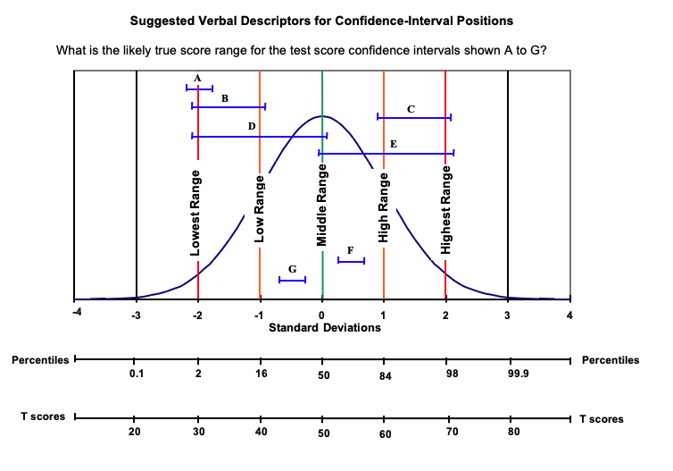
Task 2 – Present a PCL-R Facet
1. Find the range on the normal curve
2. Match this to a descriptor
3. Write down your interpretation
4. Present on a slide

